Slide 1
Semantic Similarity
WWC – Data Science with Python
Diana Amador

Slide 2
What is Semantics?
Semantics (from Ancient Greek: σημαντικός sēmantikós, "significant")
Branch of linguistics and logic concerned with meaning.
Formal semantics, which studies the logical aspects of meaning, such as sense, reference, implication, and logical form,
Lexical semantics, which studies word meanings and word relations
Conceptual semantics, which studies the cognitive structure of meaning.

Slide 3
What is Semantic Similarity?
Artificial Intelligence and Linguistics
Information Retrieval is largely based on the similarity identification measures between documents.
Problem: focus on words, but ignoring ontological relationships between words.

Slide 4
Why?
Measurement of similarity between text segments or concepts is very useful for many applications:
Information retrieval
Ontology matching
Text mining
Question answering
Text Correction

Slide 5
What is an Ontology?
A consensus is now established about the definition and the role of an ontology in knowledge engineering: "an ontology is a formal, explicit, specification of a shared conceptualization.“
Used in cognitive modeling

Slide 6
More about Ontologies…
An ontology is a schema (model) describing the types (and possibly some individuals) in a domain, the relationships that may exist between types and individuals, and constraints on the way that individuals and properties may be combined.
UML: Unified Model Language

Slide 7
Ontology Example
Classes: Project, Person, ProjectManager. ProjectManager is a subclass of Person (apparently). People and Projects are disjoint
Relationships: worksOn, manages. Manages is a sub-property of worksOn
Constraints: People work on Projects, not the other way around. Only Project Managers can manage projects.
This simple example enables machine inferences, e.g. if X manages Y, then we can infer that Y is a Project, and X is a Project Manager and therefore a Person.

Slide 8
UMLS Semantic Network
The Unified Medical Language System® (UMLS®) Semantic Network consists of:
a set of broad subject categories, or semantic types, that provide a consistent categorization of all concepts represented in the UMLS Metathesaurus®, and
a set of useful and important relationships, or semantic relations, that exist between semantic types.
Info: https://www.nlm.nih.gov/pubs/factsheets/umlssemn.html

Slide 9
UMLS Structure and Content
There are 133 semantic types and 54 semantic relationships.
Major groupings of semantic types include:
organism
anatomical structure
biologic function
chemical
physical object
idea or concept
The primary link between the semantic types is the ”isa” link. The isa link establishes the hierarchy of types within the Semantic Network and facilitates the assignment of the most specific semantic type available for a Metathesaurus concept.

Slide 10
UMLS Structure and Content
There are also five major categories of non-hierarchical relationships:
physically related to
spatially related to
temporally related to
functionally related to
conceptually related to
Each semantic type record includes:
a unique identifier
a tree number indicating its position in an ‘isa’ hierarchy
a definition
its immediate parent and children.
Each semantic relationship record includes a unique identifier, a tree number, a definition, and the set of semantic types that plausibly can be linked by this relationship.

Slide 11
Wu & Palmer
The Wu & Palmer measure (wup) calculates similarity by considering the depths of the two concepts in the UMLS, along with the depth of the LCS The formula is score = 2*depth(lcs) / (depth(s1) + depth(s2)).
This means that 0 < score <= 1. The score can never be zero because the depth of the LCS is never zero (the depth of the root of a taxonomy is one).
The score is one if the two input concepts are the same.
UML: Unified
LCS: Lexical Conceptual Structure

Slide 12
WordNet
WordNet® is a large lexical database of English. Nouns, verbs, adjectives and adverbs are grouped into sets of cognitive synonyms (synsets), each expressing a distinct concept.
Synsets are interlinked by means of conceptual-semantic and lexical relations.
The resulting network of meaningfully related words and concepts can be navigated with the browser. WordNet is also freely and publicly available for download.
WordNet's structure makes it a useful tool for computational linguistics and natural language processing.
https://wordnet.princeton.edu/

Slide 13
WordNet Structure
The main relation among words in WordNet is synonymy
Synonyms--words that denote the same concept and are interchangeable in many contexts--are grouped into unordered sets (synsets).
Each of WordNet’s 117 000 synsets is linked to other synsets by means of a small number of “conceptual relations.”
A synset contains a brief definition (“gloss”)
Each form-meaning pair in WordNet is unique.

Slide 14
WordNet Relationships
Super-subordinate relation (also called hyperonymy, hyponymy or ISA relation): general to Specific.
{furniture, piece_of_furniture} to {bed} to {bunkbed}
Meronymy, the part-whole relation holds between synsets
{chair} and {back, backrest}, {seat} and {leg}
Verb synsets are arranged into hierarchies as well;
verbs towards the bottom of the trees (troponyms) express increasingly specific manners characterizing an event, as in {communicate}-{talk}-{whisper}
Adjectives are organized in terms of antonymy.
Pairs of “direct” antonyms like wet-dry and young-old reflect the strong semantic contract of their members.

Slide 15
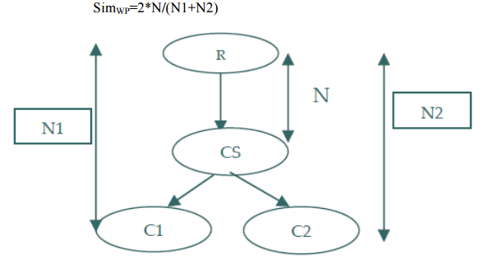
Wu & Palmer Concept Hierarchy

Slide 16
Path Length
A simple node-counting scheme (path). The similarity score is inversely proportional to the number of nodes along the shortest path between the concepts. The shortest possible path occurs when the two concepts are the same, in which case the length is 1. Thus, the maximum similarity value is 1.

Slide 17
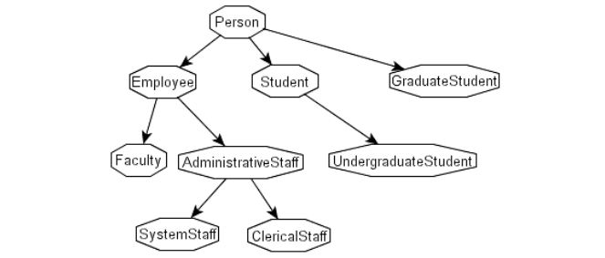
Tree Example

Slide 18
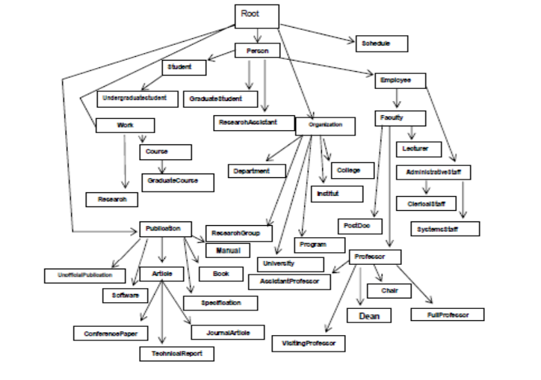
Extended Tree

Slide 19
Leacock & Chodorow
The similarity measure proposed by Leacock and Chodorow (lch) is -log (length / (2 * D)), where length is the length of the shortest path between the two concepts (using node-counting) and D is the maximum depth of the taxonomy.

